Slide 1
Using Deep Learning Techniques to Predict Currency Pairs: A Focus on USD/NGN
181103056 – Samir Salihu-Lukman

Slide 2
Table of Contents
Abstract
Introduction
Problem Statement
Aim & Objectives
Literature Review
Architecture
Dataset
System Requirements
Experimentation
Results
Conclusion
Reference

Slide 3
Abstract

Slide 4
The price of the USD/NGN exchange rate is one of the most talked about topics in the country. Among other modern tools, deep learning has recently been applied for automatic feature selection and market prediction. However, in experiments reported so far, no attention has been paid to the USD/NGN currency pair as a possible source of information for extracting features. In this paper, I adopt a CNN(Convolutional Neural Network)-based framework, that can be applied to a collection of data from a variety of sources, including different markets, in order to extract features for predicting the future of those markets. The suggested framework has been applied for predicting the next day's direction of movement for the USD/NGN currency pair based on various sets of initial variables.

Slide 5
Introduction

Slide 6
Currency
A generally accepted form of payment for goods and services.
Currency Pairs
A price quote of the exchange rate between two different countries.
Forex Market
Buying, selling, and exchanging currencies at current or determined prices.
Globally decentralized.
Determines exchange rates for every currency.
Advantages of understanding Forex Market
It is a large and global market.
It is open 24 hours a day.
It has high liquidity.

Slide 7
Deep Learning
A subset of machine learning.
Essentially a neural network with 3 or more layers.
Neural networks attempt to simulate the behaviour of the human brain.
Why is it useful to apply deep learning to Forex Markets?
Informed trading.
Improved accuracy.
Time saving.
How deep learning can be used in Forex Markets
Predicting future price movements.
A better understanding of historical prices.

Slide 8
Problem Statement

Slide 9
Financial Markets are the beating heart of the economy.
A strong forecast would be useful.
Forex trading is extremely time-consuming.
Forex is the largest market in the world ($6.6 trillion daily).
There is very little research on predictive models in Forex.
Focus is on the Stock market and general market prediction.

Slide 10
Aim & Objectives

Slide 11
Aim
To predict the direction of the USD/NGN currency pair for a specific time period.

Slide 12
Objectives
To research the best model/architecture that would better suit my problem domain.
To modify and finetune the model/architecture to my problem domain.
To evaluate the model/architecture.

Slide 13
Literature Review

Slide 14
Paper | Dataset | Architecture | Methodology | Evaluation Metric | Results
Algorithmic Financial Trading with Deep Convolutional Neural Networks: Time Series to Image Conversion Approach [2] | Exchange-Traded Funds(ETFs) & Dow Jones 30 stocks | Nine layers are used namely, the input layer(15x15), two convolutional layers (15x15x32, 15x15x64), a max pooling (7x7x64), two dropouts(0.25, 0.50), fully connected layers(128), and an output layer(3). | A novel method that uses CNN to determine the ”Buy” and ”Sell” points in stock prices using 15 different technical indicators with different time intervals and parameter selections for each daily stock price time series to create images. | Recall Precision F1 Score | Total accuracy of 0.58
Financial Time-series Data Analysis using Deep Convolutional Neural Networks [3] | Taiwan Stock Index Futures | This model contains 2 layers of convolution, 2 layers of pooling and a layer of output. | This paper attempted to analyze financial market price data And transformed financial time series data into two-dimensional Images as input for classifying the trend in the future. | Accuracy | An average accuracy of 54%
CNN-based stock market prediction using a diverse set of variables [4] | five major U.S. stock market indices: S&P 500, NASDAQ, Dow Jones Industrial Average, NYSE, and RUSSELL, as well as other variables including exchange rate of currencies, futures contracts, price 90 of commodities, important indices of markets around the world, price of major Companies in the U.S. market, and treasury bill rates. | Eight layers are used namely, input layer(60x82), three convolutional layers(60x1x8, 58x1x8, 27x1x8), two max pooling layers(29x1x8, 13x1x8), fully connected layers(104), and an output layer(1). | This paper introduces the architecture of CNNpred, a general CNN-based framework for stock market prediction. CNNpred has two variations that are referred to as 2D-CNNpred and 3D-CNNpred. They explain the framework in four major steps: representation of input data, daily feature extraction, durational feature extraction, and final prediction. | Macro-Averaged-F-Measure that is the mean of F-measures calculated. | 2D average is 54%. 3D average is 55%
Predicting Financial Prices of Stock Market using Recurrent Convolutional Neural Networks [5] | HSI, DAX, and S&P 500 index | A combination-based architecture of RNN and CNN, consisting of five parts of layers namely, input layer, convolutional layer, GRU layer, pooling layer, and fully connected layer. | They proposed a Recurrent Convolutional Neural Network that applies to the financial sequence perdition task. They construct the time series prediction model (GRU-CNN financial sequence prediction model) with GRU and CNN deep learning model | Daily returns and accumulative returns. | Up to 56.2% in daily and accumulative returns.
Financial Markets Prediction with Deep Learning [6] | Four commodity futures and two equity index futures including, WTI crude oil, Natural gas, Soybeans, Gold, E-mini NASDAQ 100, E-mini S&P 500 | A novel 1D convolution architecture called Cross-Data-Type 1-D CNN, which contains an input layer, convolutional layers, max pooling layers and fully connected layers. | In this paper, they propose and develop a deep convolutional neural network model (CNN) to automatically extract features from historical financial trading data and to predict the price movement. | Weighted F Score Annual return Sharpe ratio | 57.4% weighted F score 71.9% Average annual return 2.72 Sharpe ratio

Slide 15
Architecture
Two models were used: the 2D CNN model & 3D CNN model.
Based on the architecture of [1].

Slide 16
2D CNN Model
Input layer has a shape of 60 x 82.
Modifications were made to the original architecture.
50 Epoch and 0.1 droprate used, compared to 20 Epoch and 0.1 droprate of the original architecture.
Two convolutional layers were added.
Approximately 1 hour to run.
Total Parameters – 1,553.
Trainable Parameters – 1,553.

Slide 17
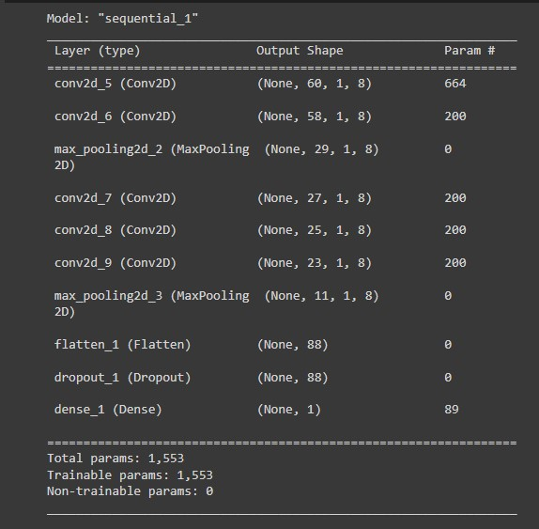
2D Model

Slide 18
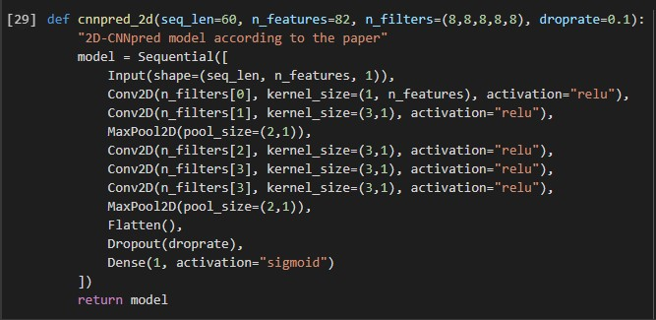
2D Model Code

Slide 19
3D CNN Model
Input layer has a shape of 5 x 60 x 82.
Modifications were made to the original architecture.
20 Epoch and 0 droprate used, compared to 20 Epoch and 0.1 droprate of the original architecture.
Two convolutional layers were removed.
Approximately 2 hours 30 minutes to run.
Total parameters – 1,865.
Trainable parameters – 1865.

Slide 20
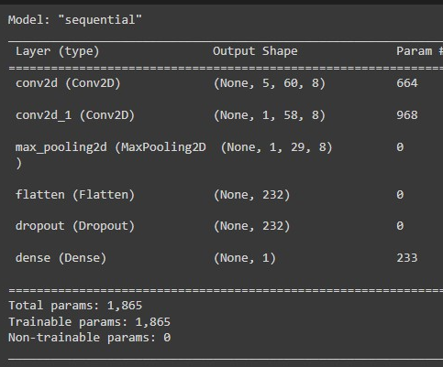
3D Model

Slide 21
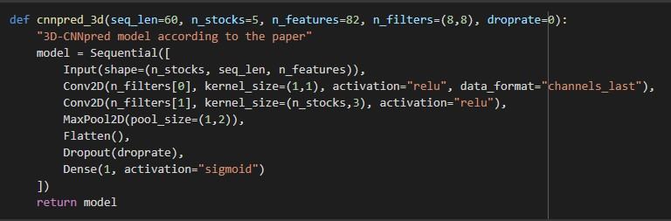
3D Model Code

Slide 22
Dataset

Slide 23
5 CSV files each for a different currency pair.
input data has a date column and a name column to identify the ticker symbol for the currency pair.
Focus is on the USD/NGN currency pair.
82 variables are used in each file ranging from primitive variables, technical indicators, and world stock market indexes to many other crucial factors that may influence the currency pair.
Other CSV files include currency pairs related to the USD.
Namely, AUD/USD, EUR/USD, GBP/USD, USD/JPY.
All used in 3D CNN Model.
Historical data range is from 31st December 2009 to 15th November 2017.

Slide 24
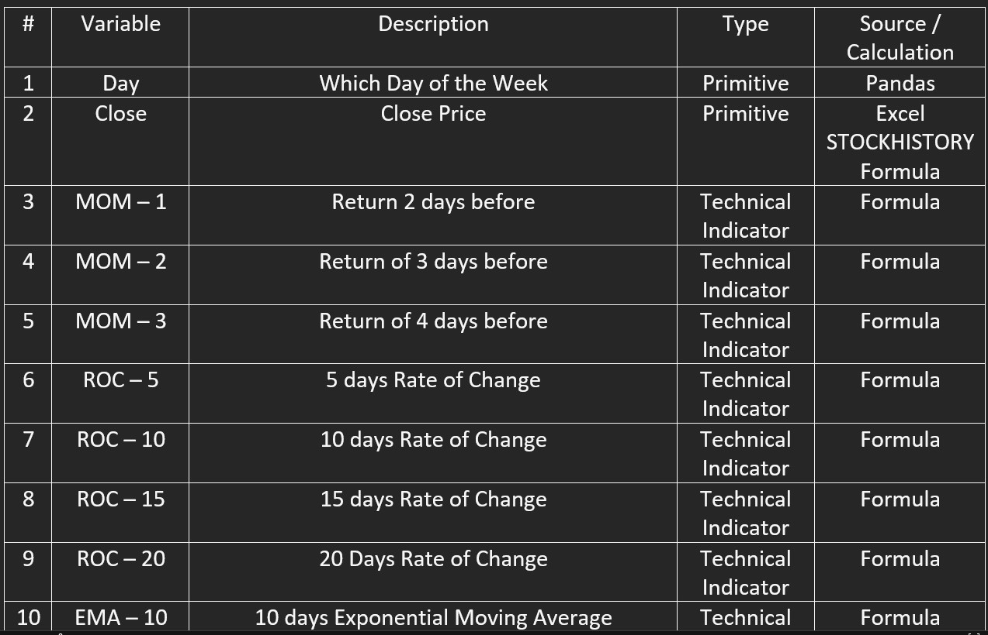

Slide 25
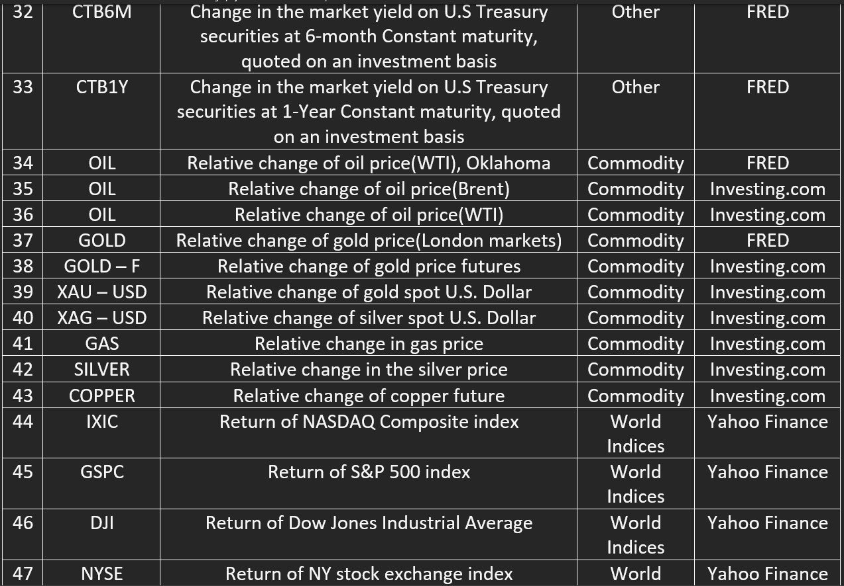

Slide 26
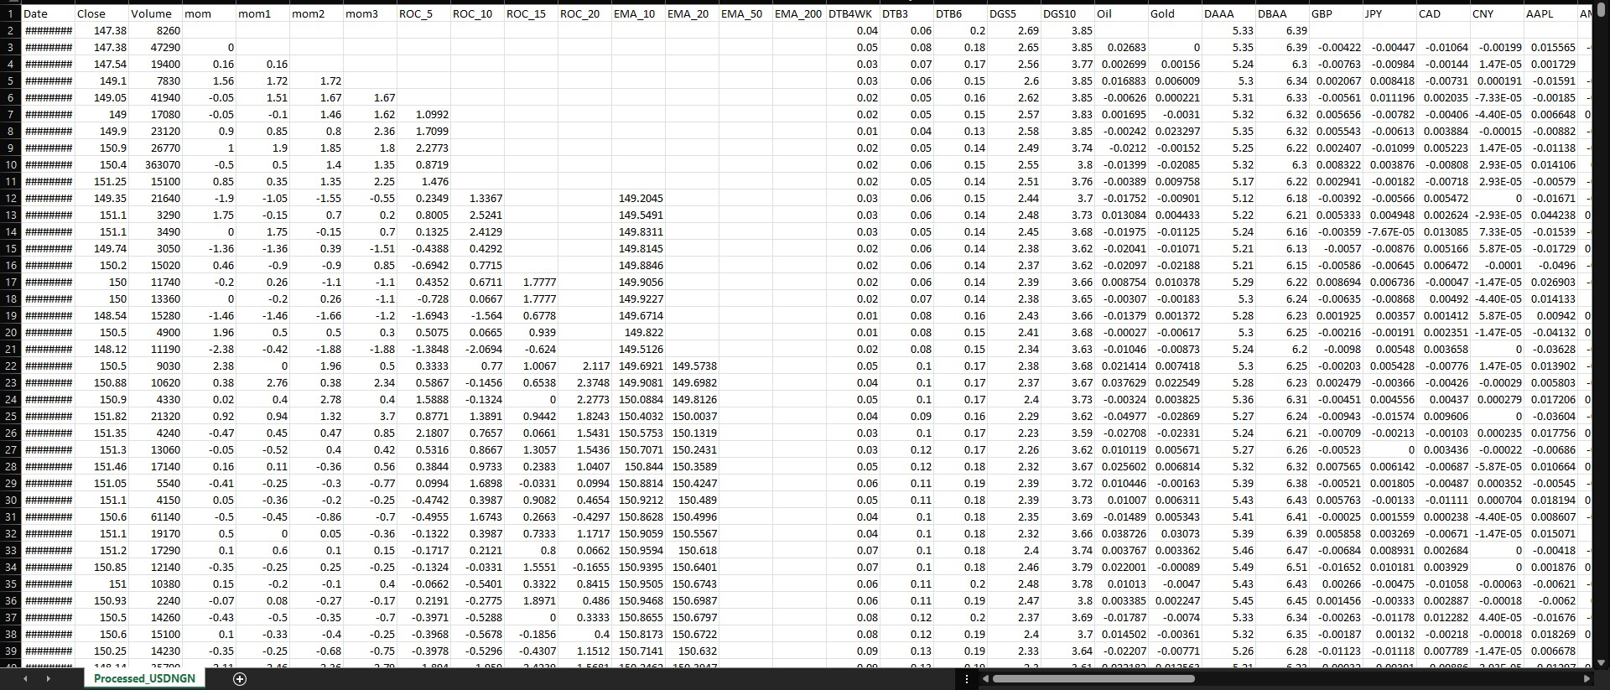

Slide 27
System Requirements

Slide 28
Minimum Specifications needed
RAM – 16GB
CPU – Intel corei7 7th Generation
GPU – Nvidia GeForce 10 series/AMD Radeon series
Storage – 1TB HDD/256GB SSD
OS – Windows/Linux/macOS

Slide 29
Software tools used
Google Colab – Implementation of the system and improvements based on the proposed dataset.
Runtime Type - GPU
Python v3.7 – The programming language used to implement the model.

Slide 30
Packages used
NumPy – Linear Algebra operations(multidimensional arrays and matrices).
Pandas – provides DataFrame for storing the dataset.
Scikit-Learn – Implementing logistic regression and finetuning the model.
TensorFlow – Training of deep Neural Networks.

Slide 31
Experimentation

Slide 32
Various experiments run on the models include.
Increasing and reducing batch size ranging from 80 – 256.
Epoch ranging from 10 up to 40.
Droprate of 0 to 0.2.
Tweaking of filters.
Multiple loss functions experimented on including, mean squared error, mean bias error, cross-entropy loss, etc.
Settled on mean absolute error.
All this to achieve the best possible result.

Slide 33
Results

Slide 34
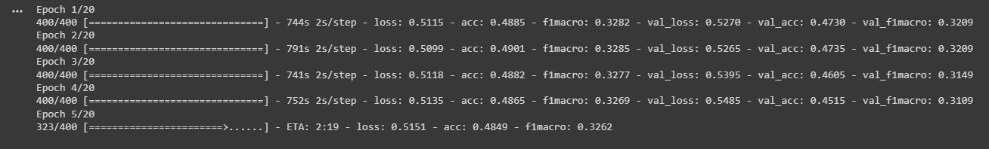
Training model

Slide 35
2D CNN Model
High accuracy is unrealistic.
Evaluation metrics used are Accuracy, Loss, and F1 Score.
Produced average accuracy of 53% over 10 instances.
Produced an average F1 score of around 0.4 over 10 instances.

Slide 37
3D CNN Model
High accuracy is unrealistic.
Evaluation metrics used are Accuracy, Loss, and F1 Score.
Produced average accuracy of 53% over 10 instances.
Produced an average F1 score of around 0.6 over 10 instances.

Slide 39
Conclusion

Slide 40
This research may be of some use.
It is not a magic formula to making money.
This model performs better than multiple baseline models.
Over a certain sample space 2D and 3D models have similar accuracy.
3D F1 score is significantly higher than the 2D model.
Given enough time better results can be achieved.

Slide 41
Reference

Slide 42
[1]A. Tam, "Using CNN for financial time series prediction", Machine Learning Mastery, 2022. [Online]. Available: https://machinelearningmastery.com/using-cnn-for-financial-time-series-prediction/. [Accessed: 14- Jul- 2022].
[2]O. Sezer and A. Ozbayoglu, "Algorithmic financial trading with deep convolutional neural networks: Time series to image conversion approach", Applied Soft Computing, vol. 70, pp. 525-538, 2018. Available: 10.1016/j.asoc.2018.04.024.
[3]J. Chen, W. Chen, C. Huang, S. Huang and A. Chen, "Financial Time-Series Data Analysis Using Deep Convolutional Neural Networks", 2016 7th International Conference on Cloud Computing and Big Data (CCBD), 2016. Available: 10.1109/ccbd.2016.027 [Accessed 14 July 2022].
[4]E. Hoseinzade and S. Haratizadeh, "CNNpred: CNN-based stock market prediction using a diverse set of variables", Expert Systems with Applications, vol. 129, pp. 273-285, 2019. Available: 10.1016/j.eswa.2019.03.029.
[5]M. Zulqarnain, R. Ghazali, M. Ghouse, Y. Hassim and I. Javid, "Predicting Financial Prices of Stock Market using Recurrent Convolutional Neural Networks", International Journal of Intelligent Systems and Applications, vol. 12, no. 6, pp. 21-32, 2020. Available: 10.5815/ijisa.2020.06.02 [Accessed 14 July 2022].
[6]J. Wang, T. Sun, B. Liu, Y. Cao and D. Wang, "Financial Markets Prediction with Deep Learning", 2018 17th IEEE International Conference on Machine Learning and Applications (ICMLA), 2018. Available: 10.1109/icmla.2018.00022 [Accessed 14 July 2022].

Slide 43
Thank you.

